Slide 1
Lecture 1
BT 203
Biochemistry
3-0-0-6
Prof. Ajaikumar B. Kunnumakkara
CANCER BIOLOGY LABORATORY
Department of Biosciences and Bioengineering
Indian Institute of Technology (IIT) Guwahati
Assam, INDIA

Slide 2
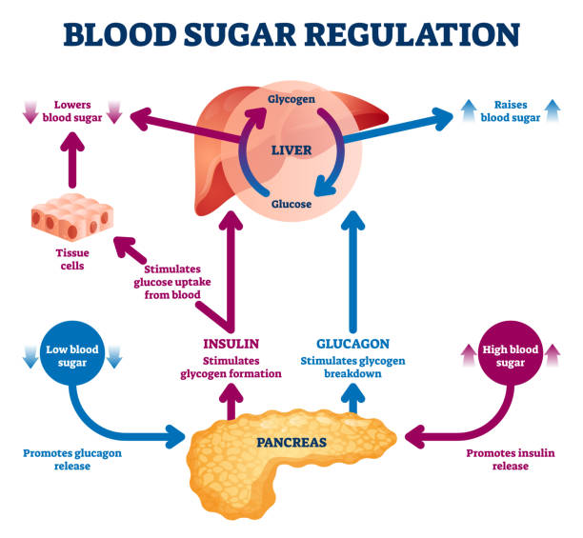

Slide 3
Insulin
Is a peptide hormone
Produced by beta cells of the pancreas
Encoded by INS gene in humans
Allows cells to absorb glucose from the blood
The higher the level of glucose, the more insulin goes into production to balance sugar levels in the blood.
Insulin also assists in breaking down fats or proteins for energy.

Slide 4
Glucagon
Is a peptide hormone
Produced by alpha cells of the islets of Langerhans of the pancreas
Produced from proglucagon Encoded by GCG gene in humans
Pancreas releases glucagon when the amount of glucose in the blood stream is very low
Glucagon increases energy expenditure and is elevated under conditions of stress.
Promotes gluconeogenesis and glycogenolysis
Glucagon also decreases fatty acid synthesis in adipose tissue and the liver, as well as promoting lipolysis in these tissues.

Slide 5
Glycogenesis
Glycogenesis is the process of storing excess glucose for use by the body at a later time.
This process is activated by insulin in response to high glucose levels and during resting periods following the Cori cycle in the liver.
Glycogenesis is the formation of glycogen from glucose. Glycogen is synthesized depending on the demand for glucose and ATP (energy).
If both are present in relatively high amounts, then the excess of insulin promotes the glucose conversion into glycogen for storage in liver and muscle cells.
In the synthesis of glycogen, one ATP is required per glucose incorporated into the polymeric branched structure of glycogen. actually, glucose-6-phosphate is the cross-roads compound.
Glucose-6-phosphate is synthesized directly from glucose or as the end product of gluconeogenesis.

Slide 6
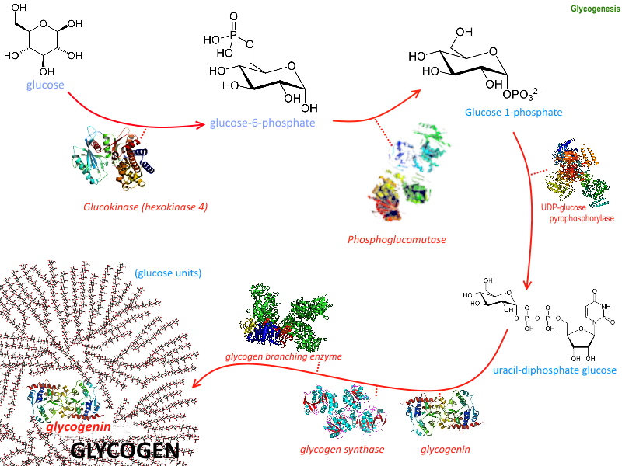
Glycogenesis

Slide 7
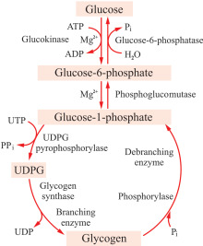
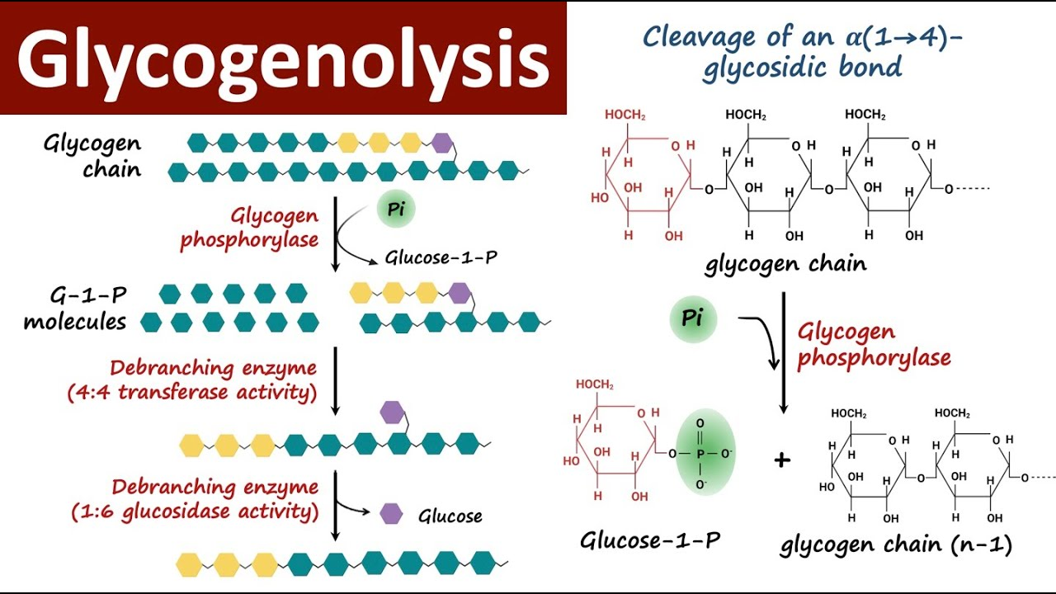
Glycogenolysis
Breakdown of glycogen (n) to glucose-1-phosphate and glycogen (n-1)
Takes place in the cells of the muscle and liver tissues in response to hormonal and neural signals.
In particular, glycogenolysis plays an important role in the fight-or-flight response (physiological reaction that occurs in response to a perceived harmful event, attack, or threat to survival) and the regulation of glucose levels in the blood.

Slide 8
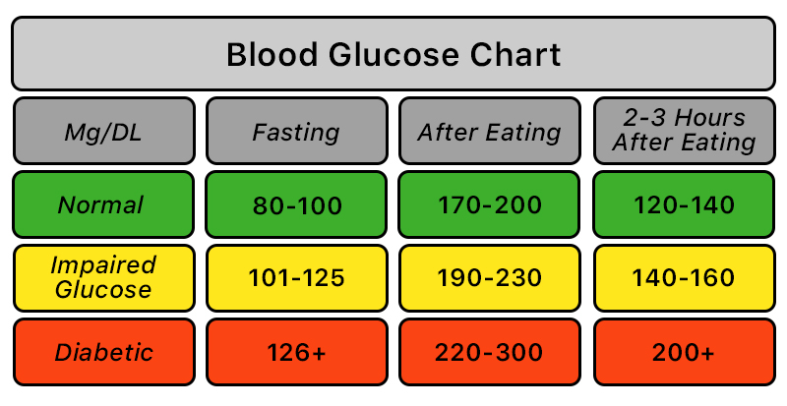
Diabetes Mellitus
Is a group of metabolic disorders characterized by a high blood sugar level (hyperglycemia) over a prolonged period of time.
Develops either by the less production of insulin by the pancreas or the body does not properly respond to insulin.

Slide 9
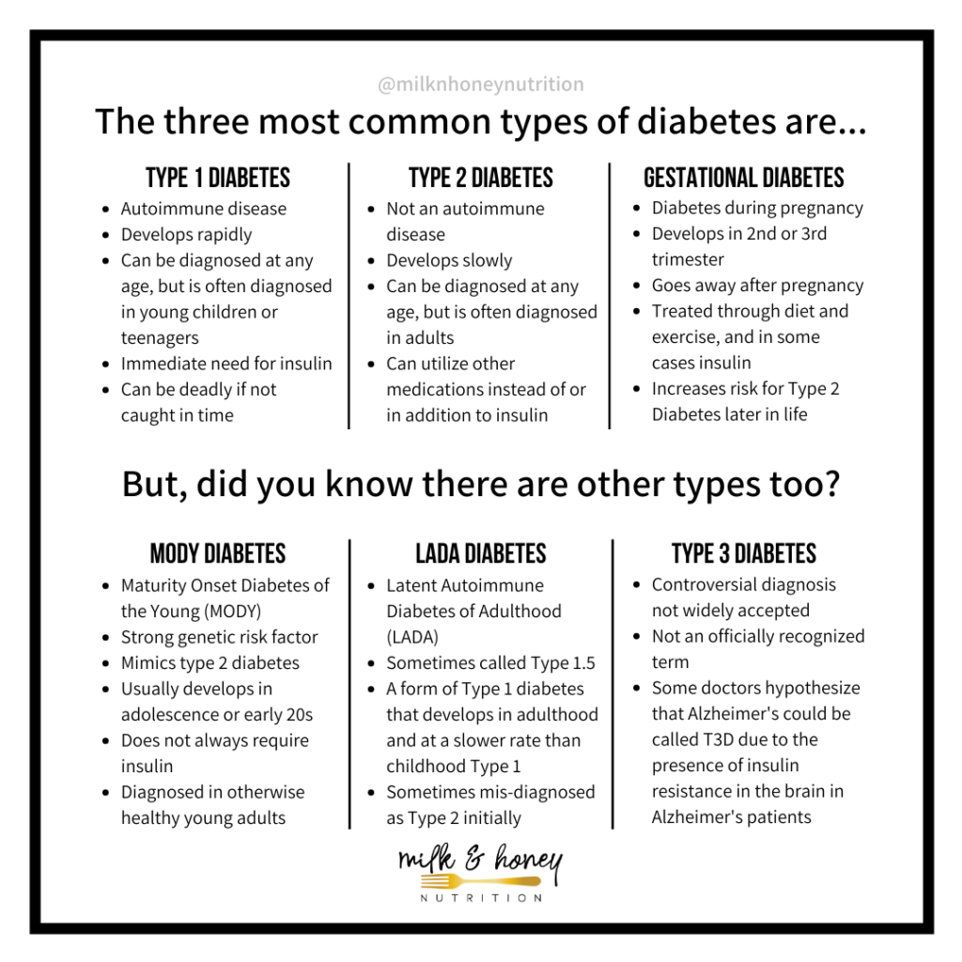
Diabetes Mellitus
Three different types

Slide 10
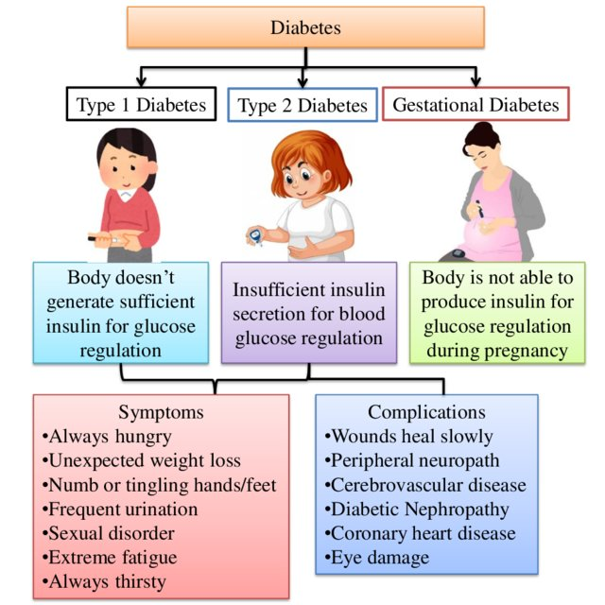
Diabetes Mellitus
Three different types
Type 2 diabetes begins with insulin resistance, a condition in which cells fail to respond to insulin properly
Type 1 diabetes must be managed with insulin injections
Type 2 diabetes may be treated with oral antidiabetic medications, with or without insulin

Slide 11
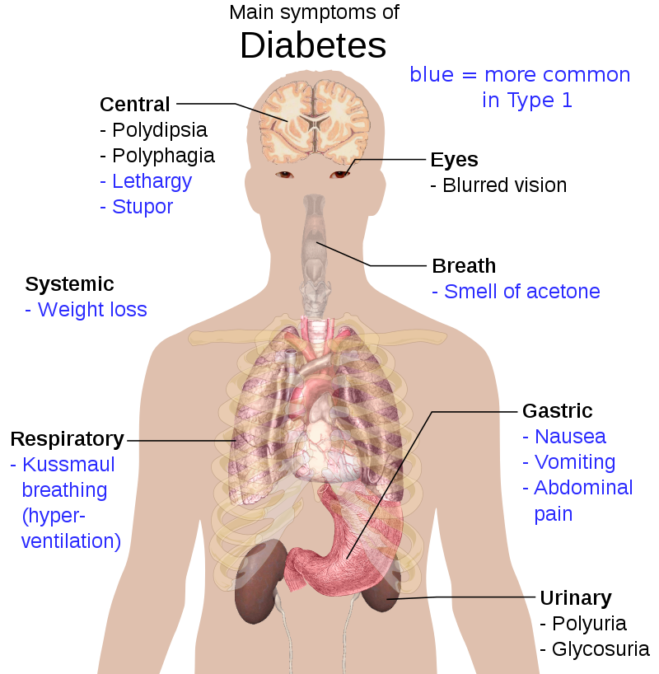
Diabetes Mellitus

Slide 12
Diabetes Mellitus
Insulin resistance
Insulin resistance is when cells in your muscles, fat, and liver don’t respond well to insulin and can’t use glucose from your blood for energy. To make up for it, your pancreas makes more insulin. Over time, your blood sugar levels go up.
Insulin resistance syndrome includes a group of problems like obesity, high blood pressure, high cholesterol, and type 2 diabetes. It could affect as many as 1 in 3 Americans. You might also hear it called metabolic syndrome.
Symptoms of Insulin Resistance
A waistline over 40 inches in men and 35 inches in women
Blood pressure readings of 130/80 or higher
A fasting glucose level over 100 mg/dL
A fasting triglyceride level over 150 mg/dL
A HDL cholesterol level under 40 mg/dL in men and 50 mg/dL in women
Skin tags
Patches of dark, velvety skin called acanthosis nigricans

Slide 13
Diabetes Mellitus
Insulin resistance
Insulin resistance is when cells in your muscles, fat, and liver don’t respond well to insulin and can’t use glucose from your blood for energy. To make up for it, your pancreas makes more insulin. Over time, your blood sugar levels go up.
Insulin resistance syndrome includes a group of problems like obesity, high blood pressure, high cholesterol, and type 2 diabetes. It could affect as many as 1 in 3 Americans. You might also hear it called metabolic syndrome.
Symptoms of Insulin Resistance
A waistline over 40 inches in men and 35 inches in women
Blood pressure readings of 130/80 or higher
A fasting glucose level over 100 mg/dL
A fasting triglyceride level over 150 mg/dL
A HDL cholesterol level under 40 mg/dL in men and 50 mg/dL in women
Skin tags
Patches of dark, velvety skin called acanthosis nigricans

Slide 14
Diabetes Mellitus
Insulin Resistance Treatment and Prevention
You can take steps to reverse insulin resistance and prevent type 2 diabetes:
Exercise. Go for at least 30 minutes a day of moderate activity (like brisk walking) 5 or more days a week. If you're not active now, work up to that.
Get to a healthy weight. If you're not sure what you should weigh or how to reach a weight loss goal, ask your doctor. You may also want to talk with a nutritionist and a certified personal trainer.
Eat a healthy diet. Think fruits, vegetables, whole grains, nuts, beans, fish, legumes, and other lean protein.
Take medications. Your doctor may prescribe a medication called metformin (Fortamet, Glucophage, Glumetza, Riomet) to help keep your blood sugar in check.

Slide 15
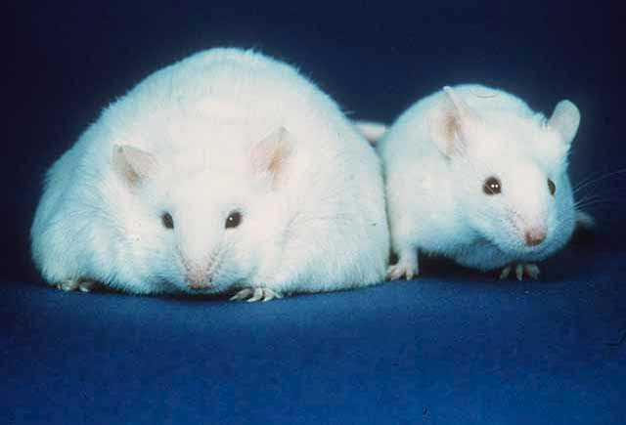
Leptin
is a hormone predominantly made by adipose cells and enterocytes in the small intestine.
helps to regulate energy balance by inhibiting hunger, which in turn diminishes fat storage in adipocytes
coded for by the LEP gene
In obesity, a decreased sensitivity to leptin occurs (similar to insulin resistance in type 2 diabetes), resulting in an inability to detect satiety despite high energy stores and high levels of leptin.
Obese mouse Normal mouse
Less leptin Leptin

